Slide 1


By
SHUBHAM SURYAWANSHI

Slide 2
Collected data from Kaggle
Read csv file for each year and created data frames with only required.
Renamed columns to make them uniform across all years
Checked for missing values and dropped rows with missing values
Renamed sub-regions to concise into region WITH LABLE ENCODING
REMOVE NULL VALUES with the help of replace
DROP UNNECESSARY COLUMNS
Apply machine learning algorithems
Data Clean Up Process

Slide 3
Problem Statement:-
Prosthetic Systems is a medical health provider with value added services towards its
customer. Due to tough completion in the niche market, its struggling to sell its products and
make profits. As they deal with only specialized products having very low volume, there is no
way they can increase the sales to make up the revenue and the profit. The management is
deciding to have a separate vertical that can finance the customers for the sales and services
for these premium products. This will enable them to stay in the market, as well as they can
expand their finance division if that rolls out well. As the company does not have a full banking
experience or is not supervised by a national or international banking regulatory agency so
they are going to tie up with a investment firm to start the company with some shared
revenue model. Now the challenge for them is to determine how they are going to select the
customers to reach out. The company wants to build a model that will help them identify the
potential customers who have a higher probability of purchasing the loan. This will increase
the success ratio while at the same time reduce the cost of the campaign.

Slide 4
Goal
You are brought in as a consultant and your job is to build the best model which can classify
the right customers who have a higher probability of purchasing the loan. You are expected
to do the following:
● EDA of the data available. Showcase the results using appropriate graphs
● Build appropriate models on both the test and train data (CART, Random Forest). Interpret
all the model outputs and do the necessary modifications wherever eligible (such as pruning)
● Check the performance of all the models that you have built (test and train). Use all the
model performance measures you have learned so far. Share your remarks on which model
performs the best.
Target Variable - Personal Loan

Slide 5
OPERATION PERFORM ON DATA
IMPORT DATASET FROM KAGGLE
IMPORT LIBRARIES FOR DATA PREPARATION AND VISUALIZATION
REMOVE NULL VALUES
PERFORM EDA AND FIND INFORMATION
FIND CORRELATION AND DESCRIBE DATA
VISUALIZATION
FIND OUTLIRE WITH THE HELP OF BOX PLOT
CONVERT CATEGORICAL TO NUMERICAL WITH LABEL ENCODER
SPLIT DATASET
APPLY MACHINE LEARNING ALGORITHEMS
EVALUATE THE MODEL
CHECK ACCURACY

Slide 6
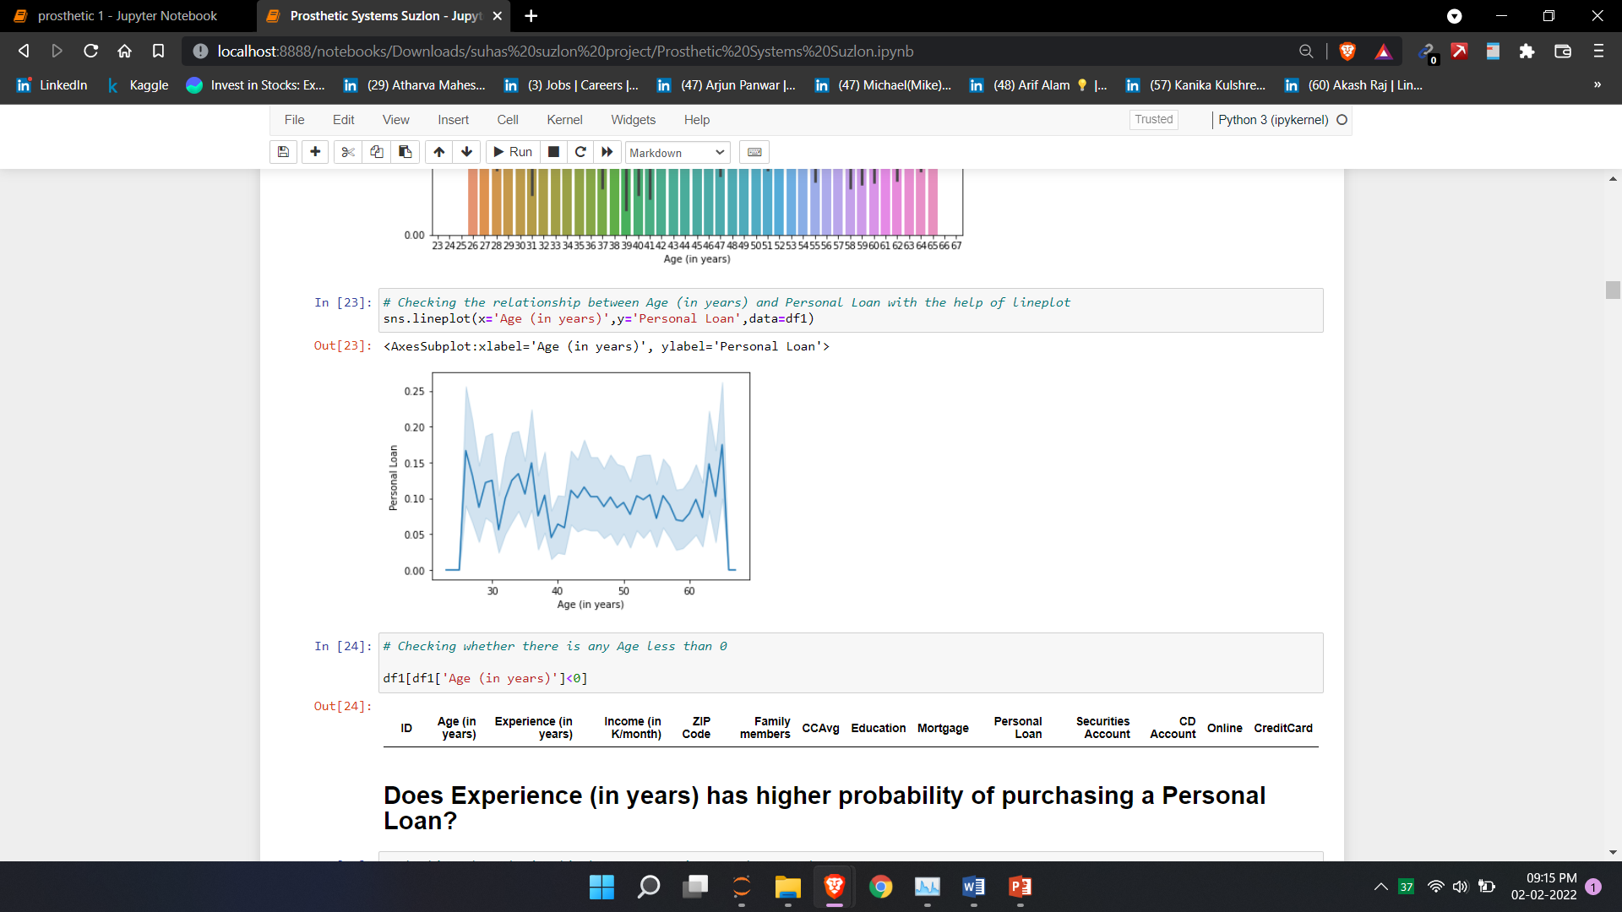
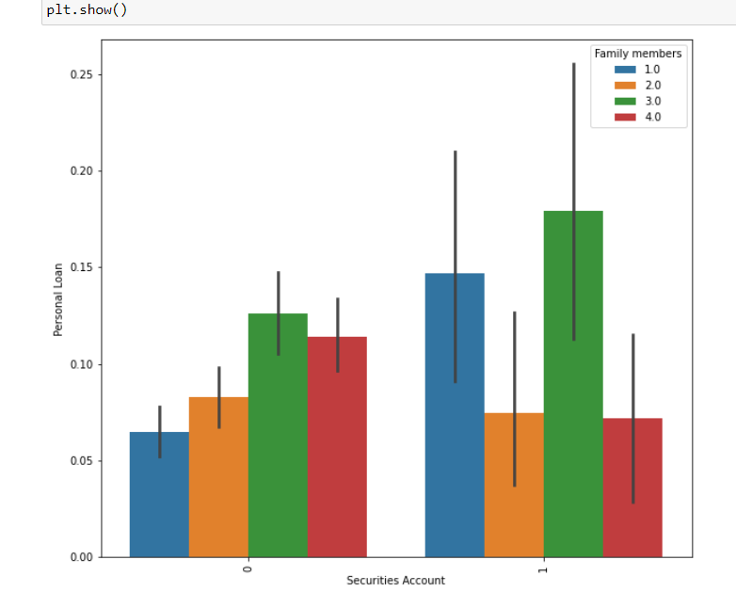
1. Checking the relationship between Age (in years) and Personal Loan with the help of lineplot
2. Checking the relationship between Securities Account and Personal Loan with respect to Family Members

Slide 7
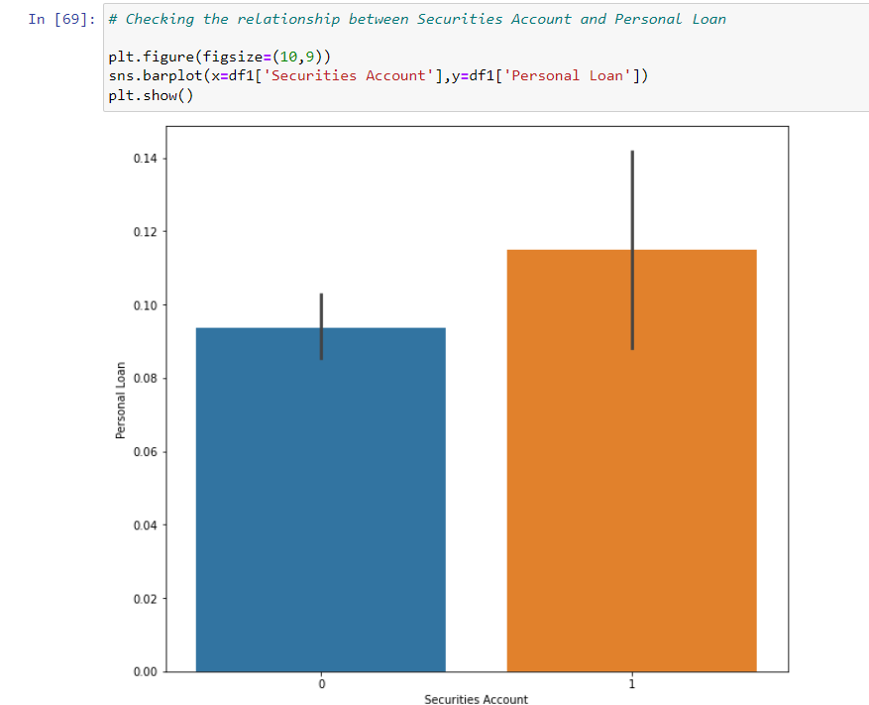
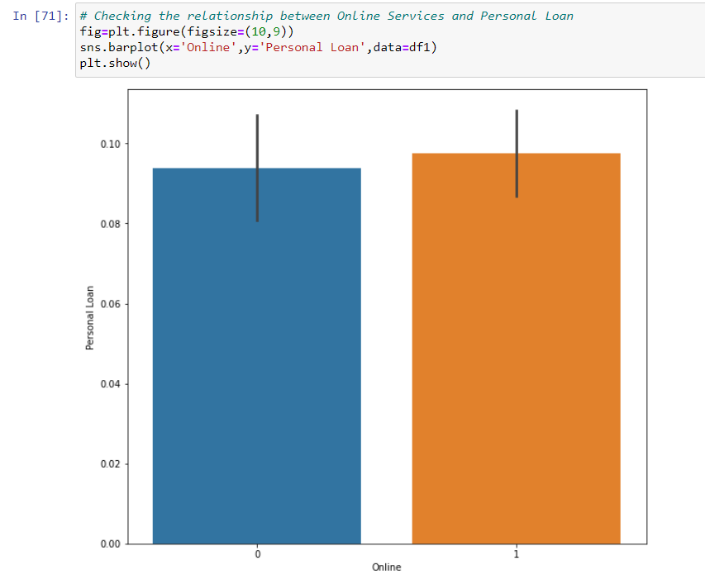
3. Checking the relationship between Securities Account and Personal Loan with respect to Family Members
4. Checking the relationship between Credit Card and CD Account with respect to Personal Loan

Slide 8
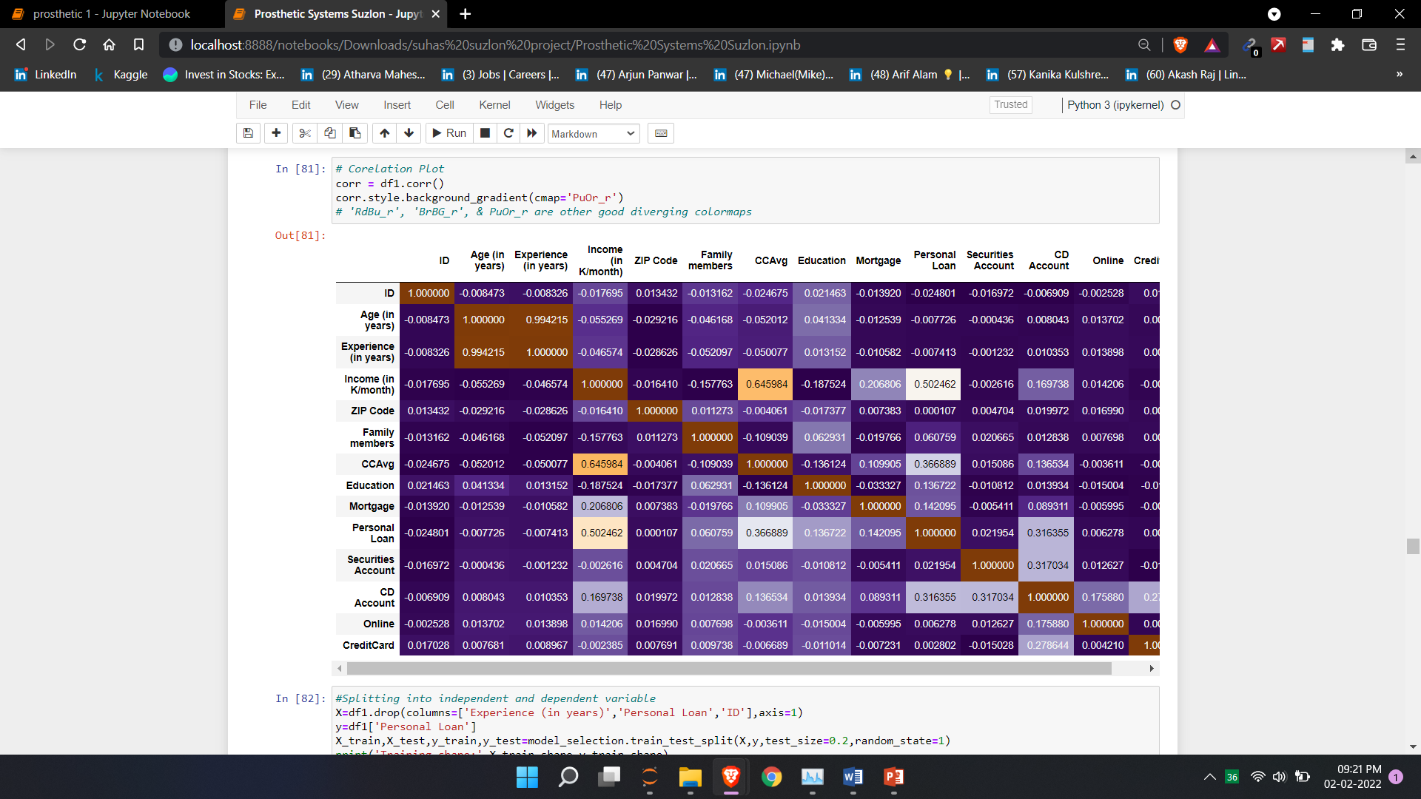
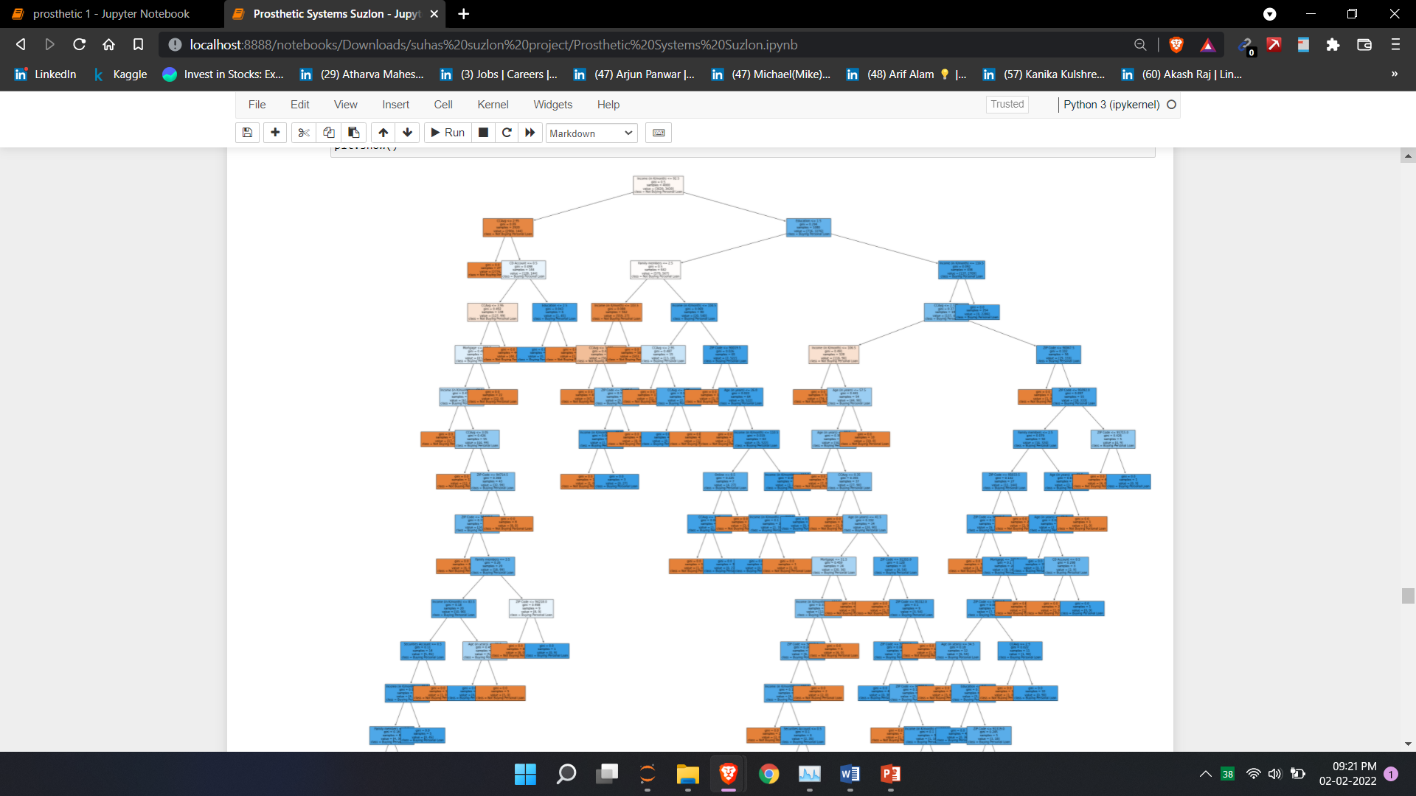
correlation
Tree

Slide 9
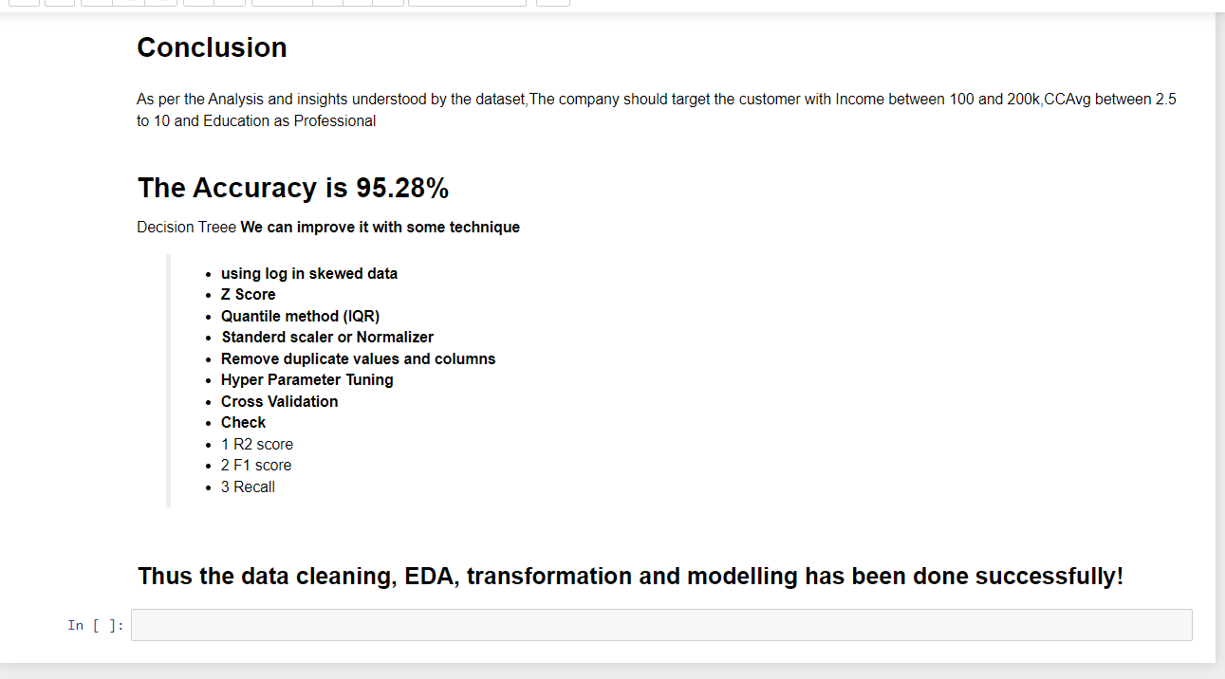

Slide 10
THANK YOU

